Slide 1
PREDICTING LOAN DEFAULTS
By: Rupin Sehgal, Rajko Gajic, Rayff McMahon
Group 8 BTMA 531 W2023

Slide 2
01
02
03
04
TABLE OF CONTENTS
Problem Formulation
DATA PREPROCESSING
Discussion/
Recommendation
Models/Results

Slide 3
01
Problem Formulation

Slide 4
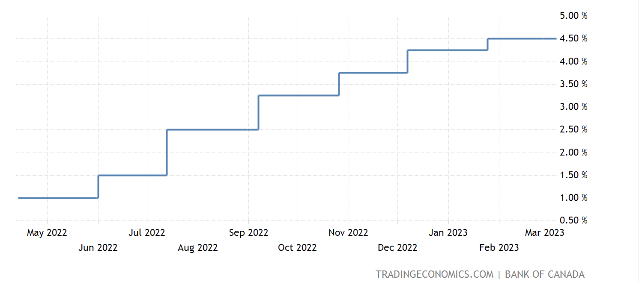
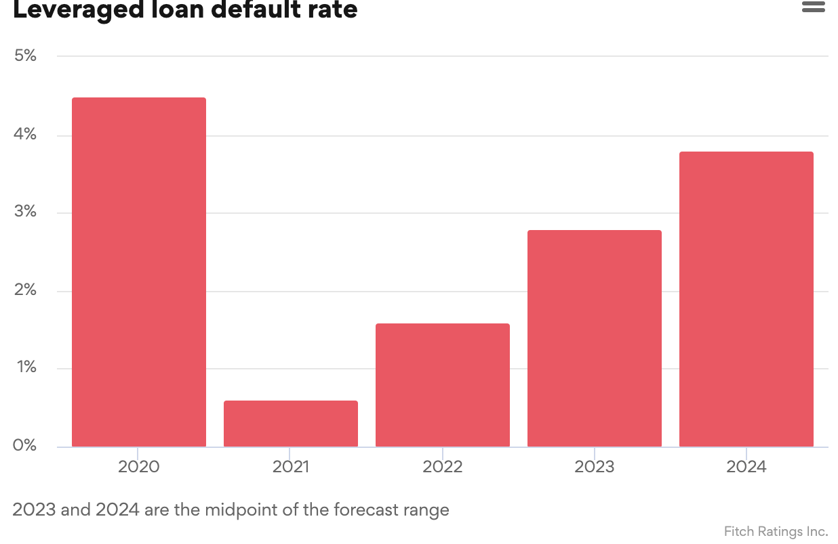
Problem
Indicators
2.5B
PCLs
Interest Rates
Economic Stress
How can big banks remain profitable from their loans while
minimizing default rates and credit losses?
A bank will lose more money giving out a loan that ends in default than not giving a loan.
Notes:
1 in 6 Canadians likely to default on major loan
Rising costs of goods
Provisions for credit loses
Big six banks put aside 2.5 billion in reserve for credit loses
Interest rates remain the same
as a result
Increases to Leveraged and high yield loan default forecasts
Pictures:

Slide 5
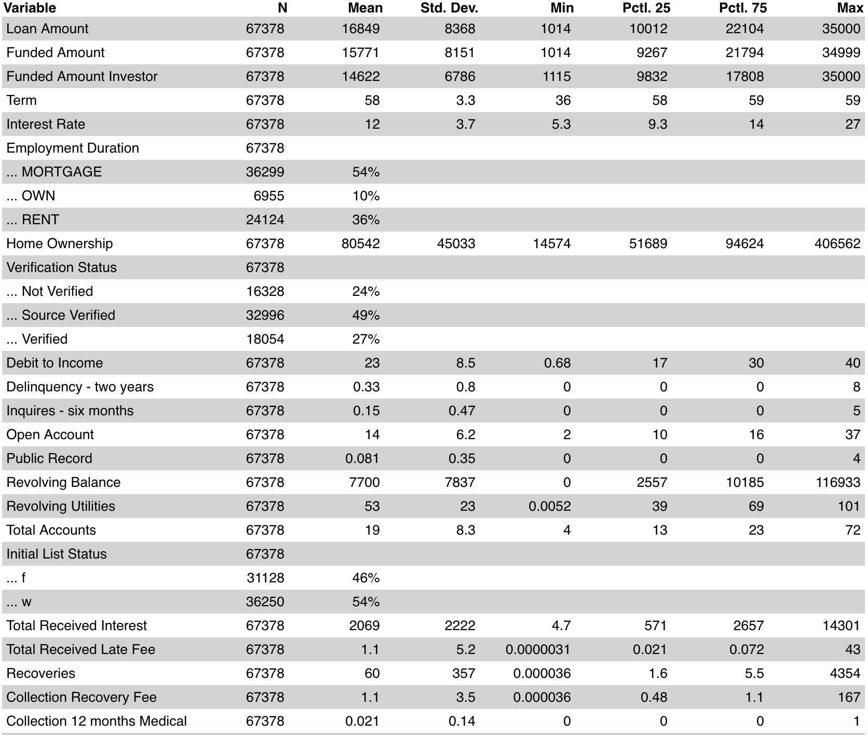
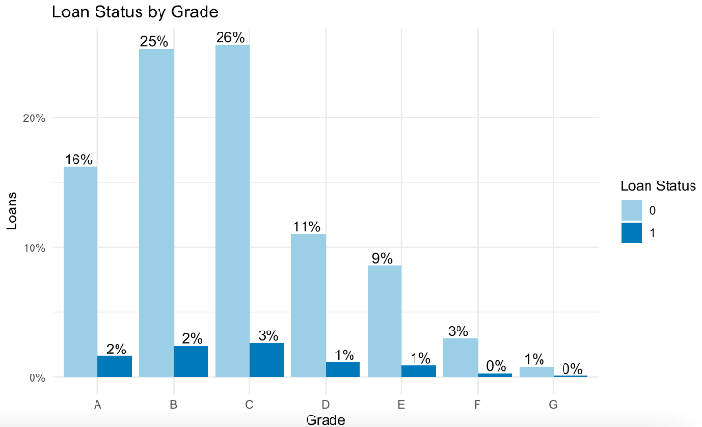
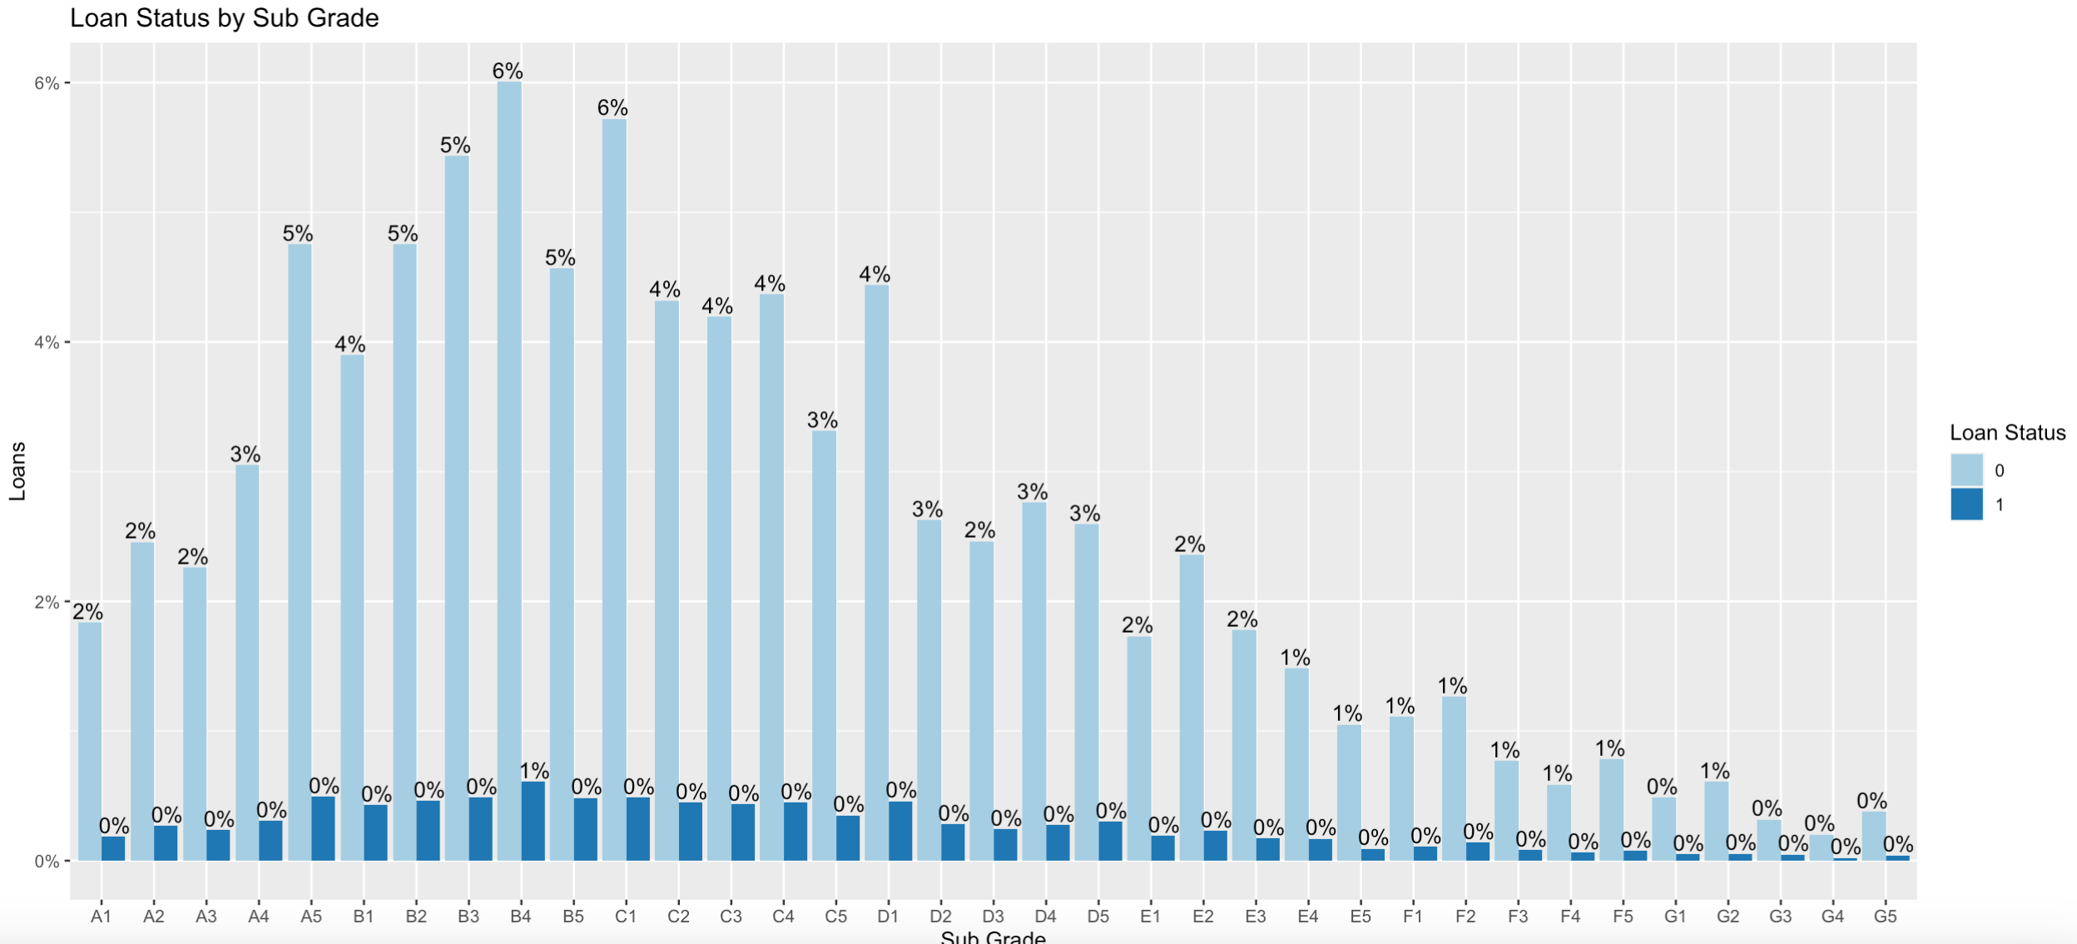
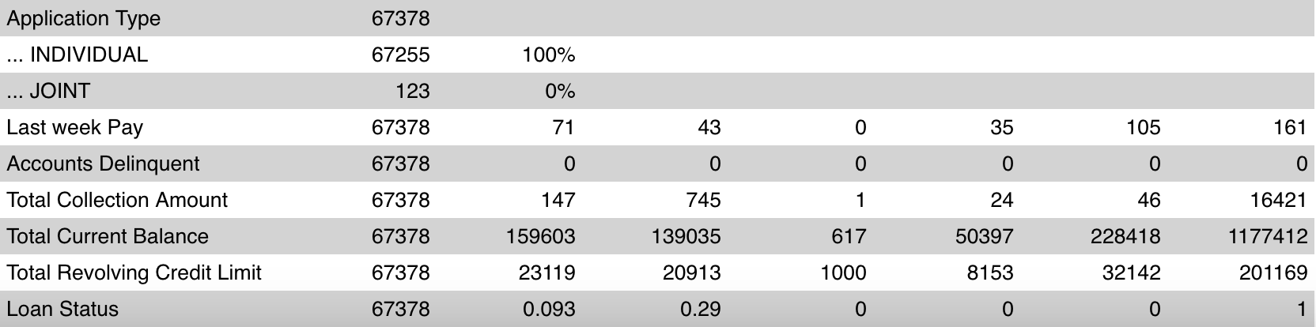
Data Summary
25 Numerical, 6 Categorical
Loan Status (Binary)

Slide 6
02
DATA PREPROCESSING

Slide 7
CATEGORY SELECTION
COLUMNS EXCLUDED
ID
Batch Enrolled
Loan Title
Payment Plan
Provided no value for analysis
Provided no value for analysis
Too many Categories to dummy code
Only one class

Slide 8
DUMMY CODING
INDIVIDUAL
Application Type
JOINT
A
A 1- 5
GRADE
B
B 1-5
MORTGAGE
C
C 1-5
EMPLOYMENT DURATION
RENT
CATEGORICAL VARIABLES
D
D 1-5
OWN
E
E 1-5
NOT VERIFIED
F
F 1-5
VERIFICATION STATUS
SOURCE VERIFIED
G
G 1-5
VERIFIED
SUB-GRADE
Initial List Status
W
=
REMOVED TO AVOID MULTICOLLINEARITY
F
Notes:
Application Type","Grade","Sub.Grade","Employment.Duration","Verification.Status","Payment.Plan",". InitialList.Status"

Slide 9
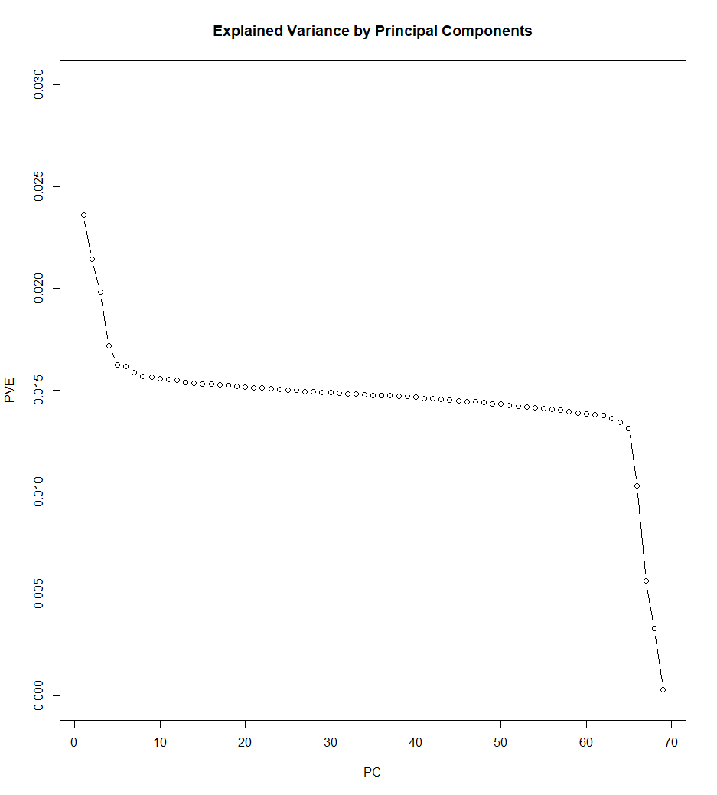
Principal Component Analysis (PCA)
What is PCA?
Purpose of PCA?
Reduces the number of variables while retaining the maximum amount of information
Simplify complex datasets and identify patterns and relationships among variables, resulting in improved model performance
Our PCA
After conducting our PCA analysis, we decided to keep 12 PCs as they explain a majority of the variation

Slide 10
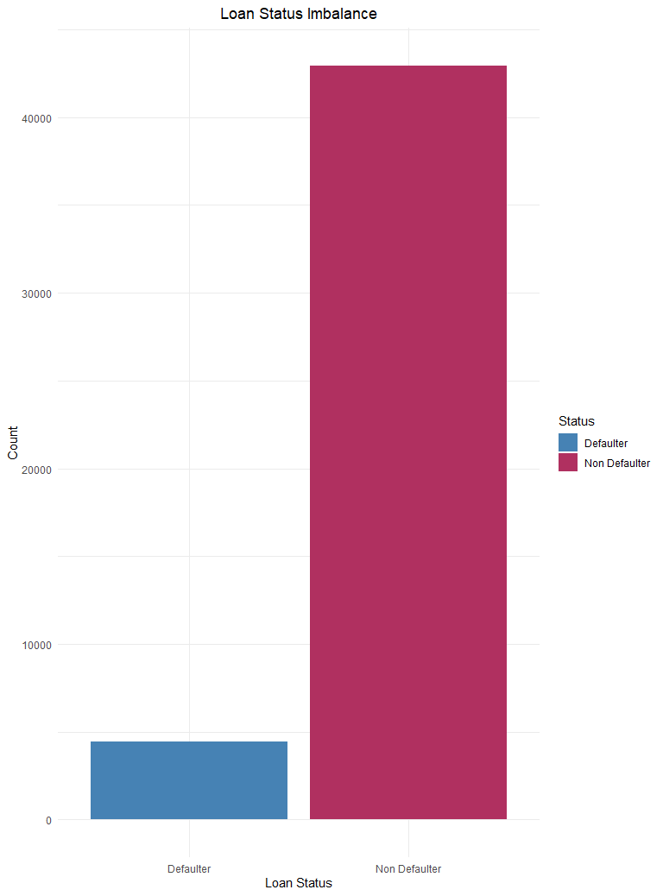
What is the Class Imbalance Problem? Sampling Methods:
Exploring Sampling Techniques
Over Sampling
Increase the number of samples in the minority class
Under Sampling
Reducing the number of instances in the majority class
Both Sampling
Combination of over sampling of the minority class and under sampling of the majority class.

Slide 11
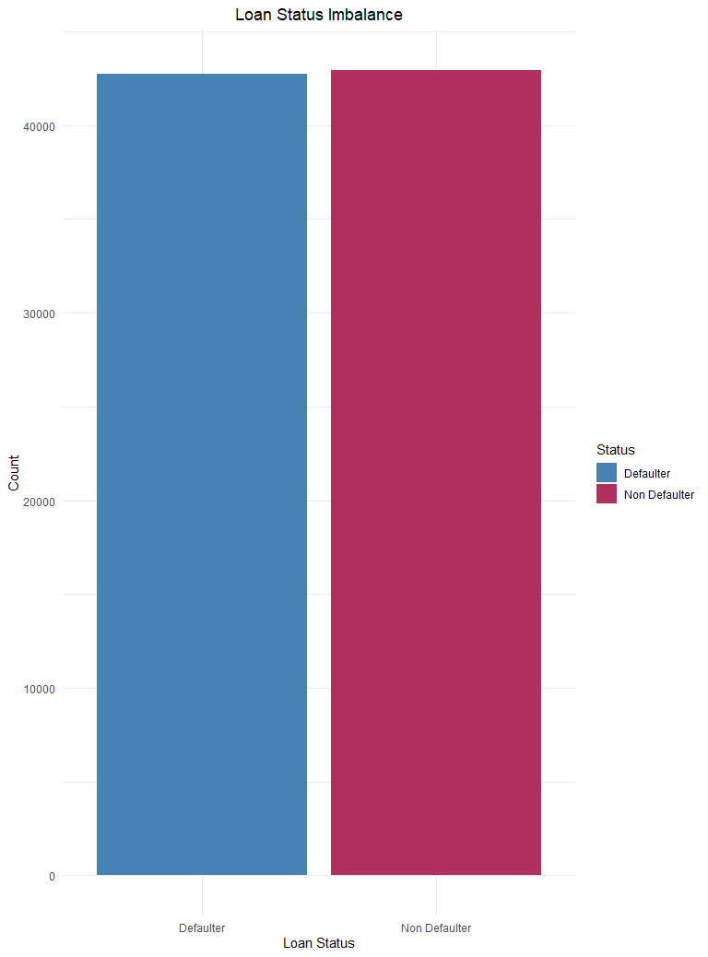
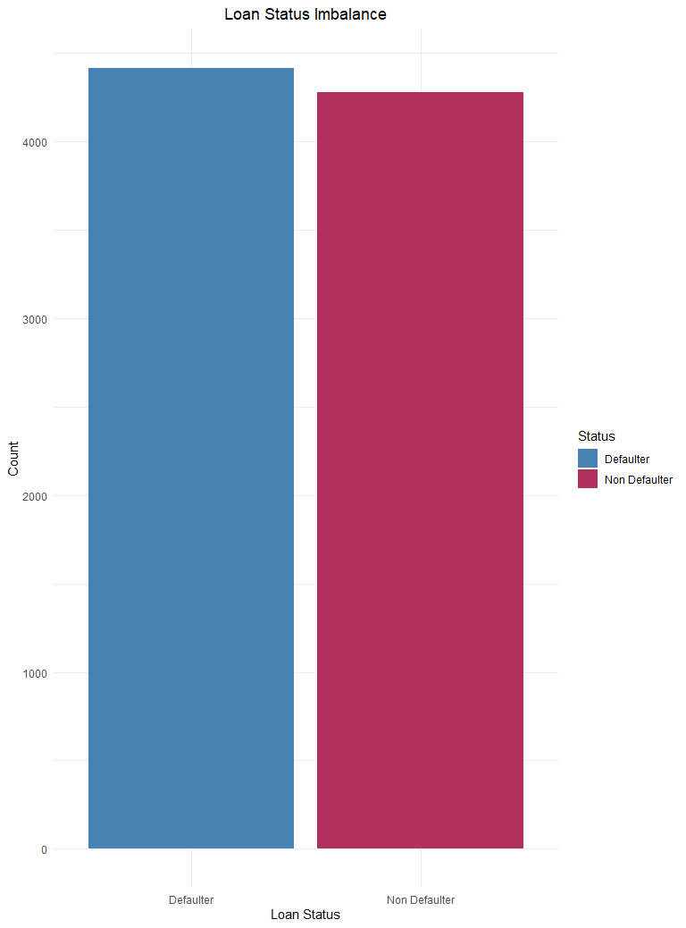

Exploring Sampling Techniques
Over Sampling
Under Sampling
Both Sampling
Note: Test class remains unaffected; sampling is only done on the train set

Slide 12
03
MODELS

Slide 13
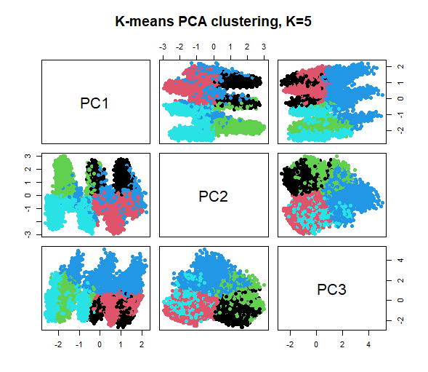
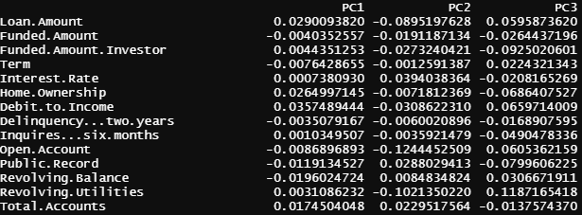
Clustering Model
Cluster
Clustering done with PCA
The first 3 PCs
Total withins:
K=3, 11669.3
K=4, 85264.41
K=5, 69000.06
K=6, 58509.17
What patterns do we see?
PC1:
Debt.to.income
PC2:
Interest.Rate
PC3:
Revolving.Utilities

Slide 14

Cross Validation

Slide 15
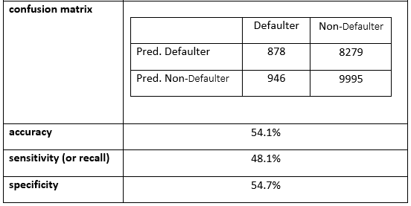
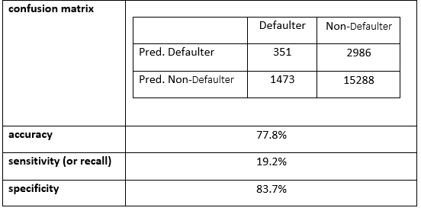
GLM Models
Basic Logistic
Best Logistic
Used the ROC Curve to find the optimal threshold to balance TP and TF
No other methods employed
We made use of weights to penalize the model for misclassifying records as FN and FP
ROC Curve to find the optimal threshold to balance TP and TF
Used Cross Validation with 5 folds to help further train the model

Slide 16
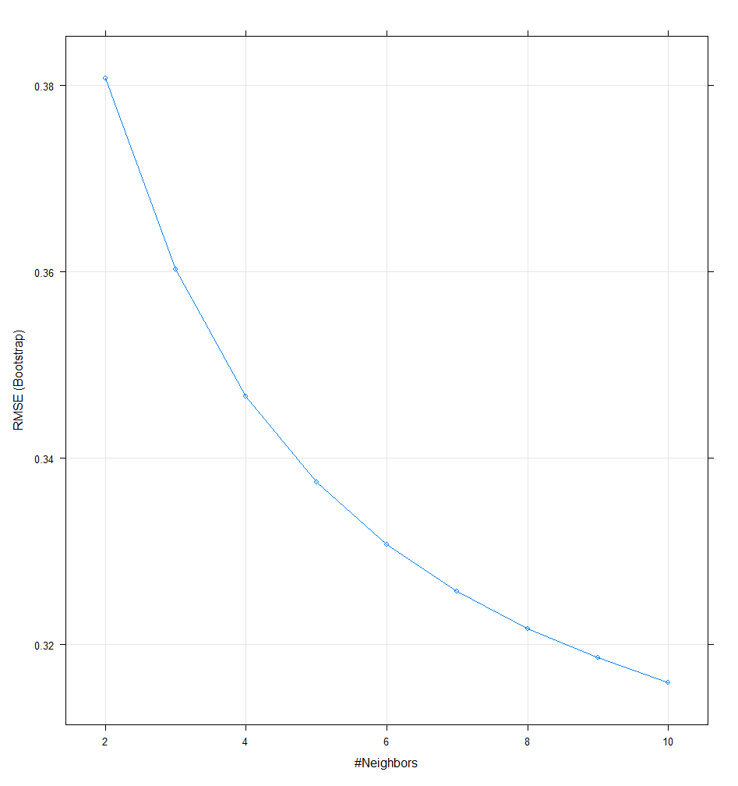
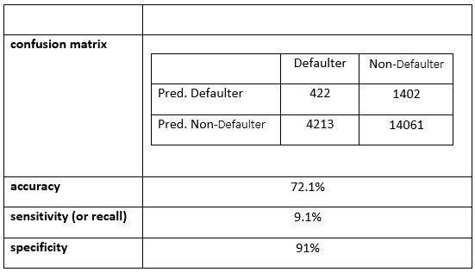
KNN Model
K Selection
Model Results
Used the ROC Curve to find the optimal threshold to balance TP and TF
KNN Model built with PCA
Chose a K of 6
Improvement in RMSE is minimal after that point

Slide 17
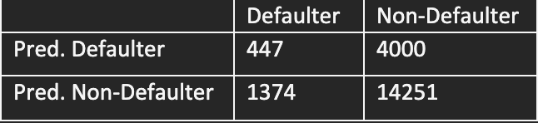
Neural Networks
Base NN
Best NN
Accuracy
91%
73%
Specificity
.02%
78%
Sensitivity
99.60%
25%
Min/Max Scaled
Un balanced Inputs
PCA and Both Sampling

Slide 18
Discussion/Recommendation
05

Slide 19
What could we do different?
Less class imbalance
Better computer for running models
Testing different models

Slide 20
Model Selection
Model Selection
= Specificity, Accuracy
Logistic Regression
= 83.7%, 77.8%
KNN
= 91%, 72.1%
Neural Net
= 78%, 73%

Slide 21
Thank You For Listening!
Questions?

